Slide 1
Secure data Hiding in Images using steganography
CAPSTONE PROJECT
Presented By
Student Name : Yanduru Vishnu Sai Vardhan
College Name & Department : KL University CSE – Data Science

Slide 2
OUTLINE
Problem Statement
Technology used
Wow factor
End users
Result
Conclusion
Git-hub Link
Future scope

Slide 3
Problem Statement
In today's digital age, secure communication remains a critical challenge. While encryption makes data unreadable, it draws attention to the very existence of secret communication. This project addresses the need for covert message transmission by implementing steganography - the art of hiding information within innocent-looking images. The solution provides a user-friendly GUI application that can embed text messages within digital images without visible alterations, making the communication process both secure and inconspicuous.

Slide 4
Technology used
Libraries & Platforms
Libraries:
OpenCV (cv2)
Tkinter & ttk
NumPy
Pillow
os
Pathlib
Platform:
Python 3.8+

Slide 5
Wow factors
Modern Dark-Themed GUI - Professional interface with real-time status updates and color-coordinated design, making steganography accessible to non-technical users.
Dual Input System - Supports both direct text input and file loading, with automatic message length validation and image capacity checking.
Enhanced Security - Password protection for encoding/decoding with robust error handling, while maintaining original image quality.
Smart Message Processing - Efficient pixel utilization and automatic message length preservation, preventing data overflow while ensuring message integrity. These features combine security with user-friendliness, setting it apart from typical steganography tools that sacrifice one for the other.

Slide 6
End users
Privacy-Conscious Individuals
Educational Sector
Security Professionals
Digital Rights Activists

Slide 7
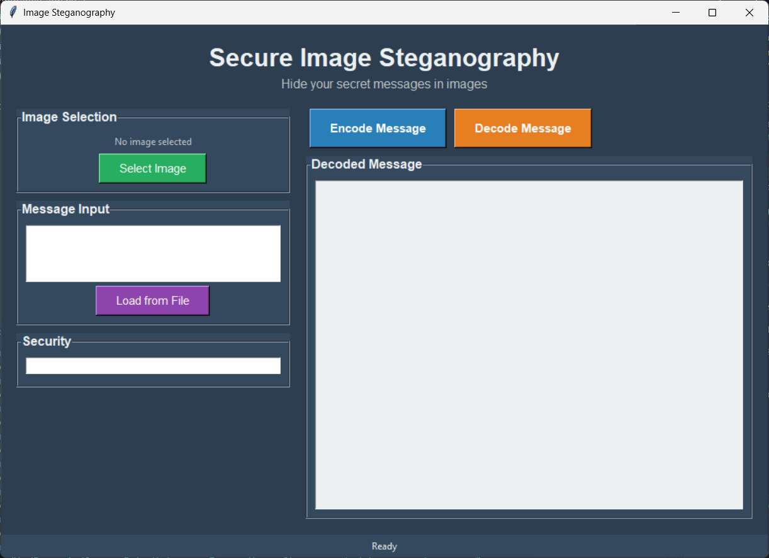
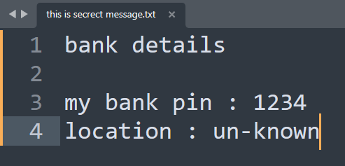
Results

Slide 8
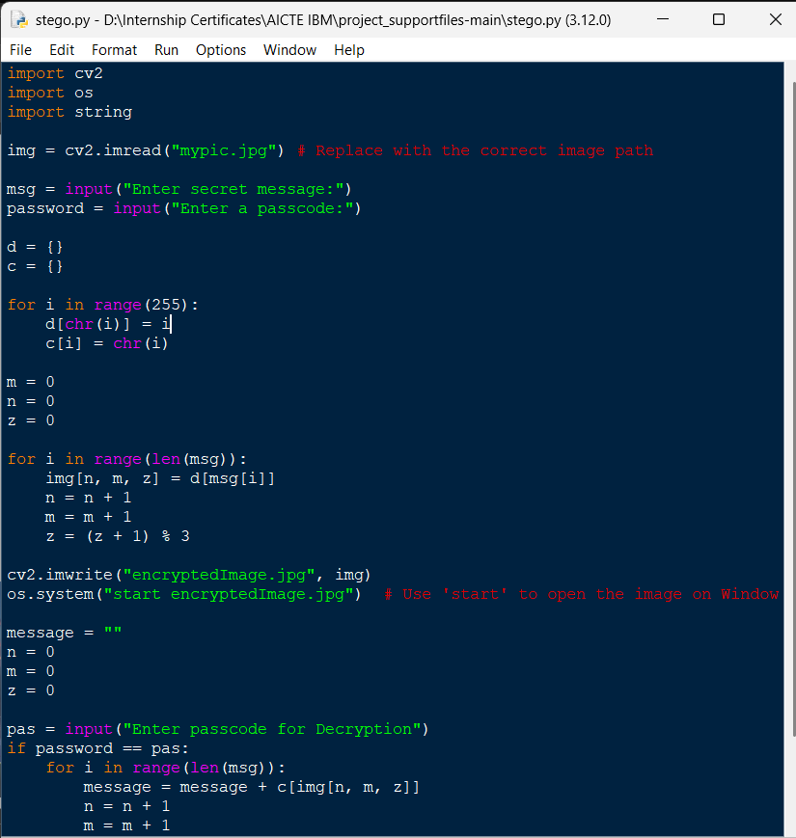

Results
Before :
After :

Slide 9
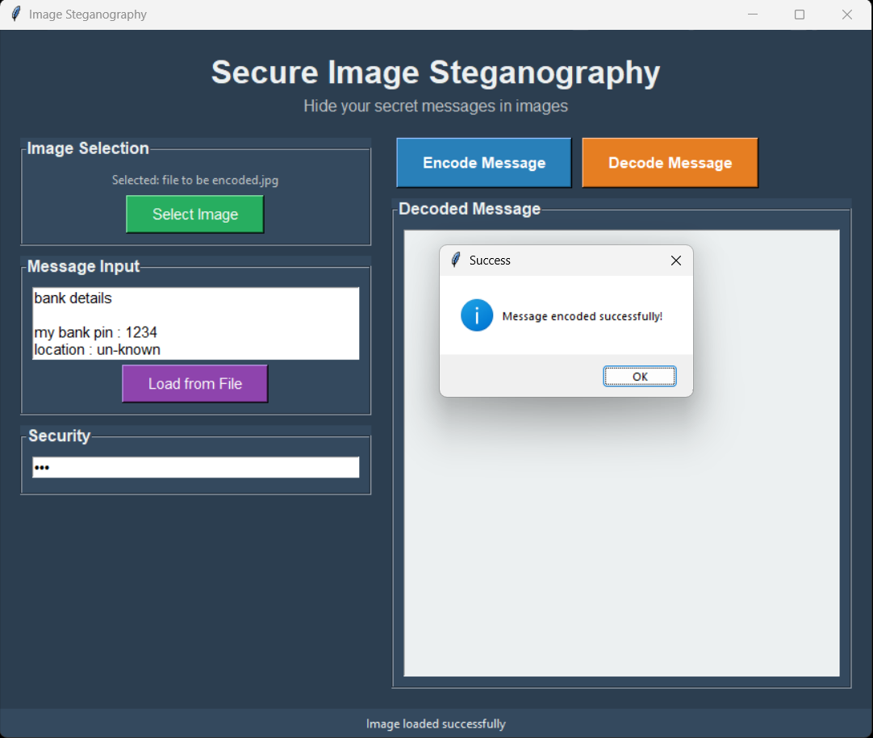
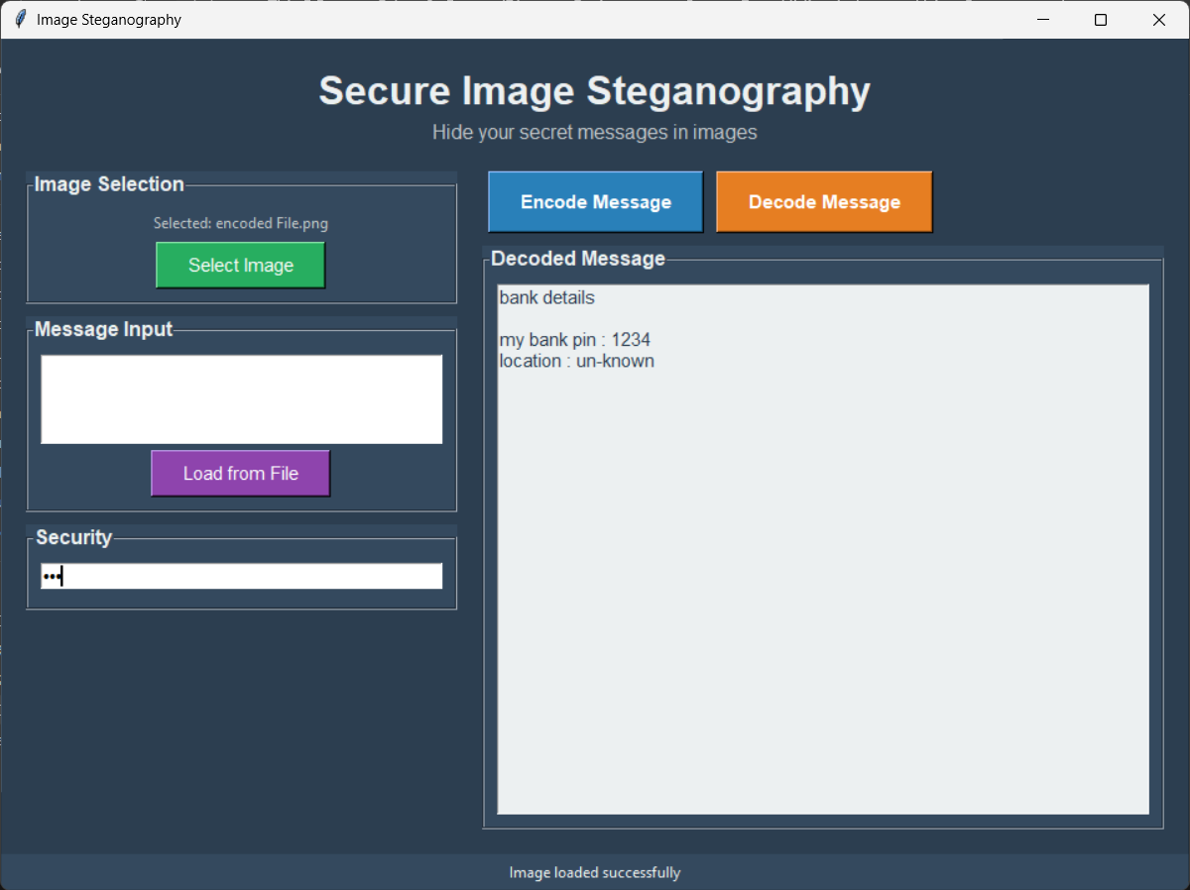
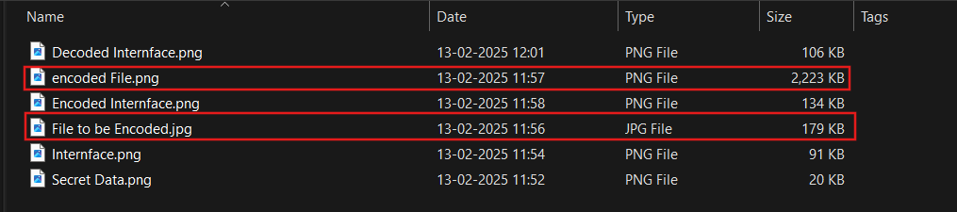
Results

Slide 10
Conclusion
This Image Steganography application successfully addresses the need for covert communication by providing a secure, user-friendly solution for hiding messages within digital images. The project achieves its core objectives by:
Security & Privacy: Successfully implementing LSB steganography with password protection, making secret messages undetectable to casual observers.
Accessibility: Creating an intuitive dark-themed GUI that makes steganography accessible to both technical and non-technical users.
Reliability: Ensuring message integrity through automatic capacity checking and efficient pixel utilization, preventing data loss or corruption.
The project effectively bridges the gap between security and usability, making secure communication available to privacy-conscious individuals, educators, and security professionals

Slide 11
GitHub Link
https://github.com/Vishnu30543/ibm

Slide 12
Future scope
Enhanced Security : Implementation of advanced encryption algorithms (AES/RSA) alongside steganography, and support for hiding messages in audio/video files.
Advanced Features : Integration of blockchain for message verification, cloud storage support for secure image sharing, and AI-powered steganography detection resistance.
Cross-Platform Development : Mobile application development (Android/iOS) and web-based version with real-time collaboration features.

Slide 13
THANK YOU

